Slide 1
Amazon Picking Challenge

Slide 2
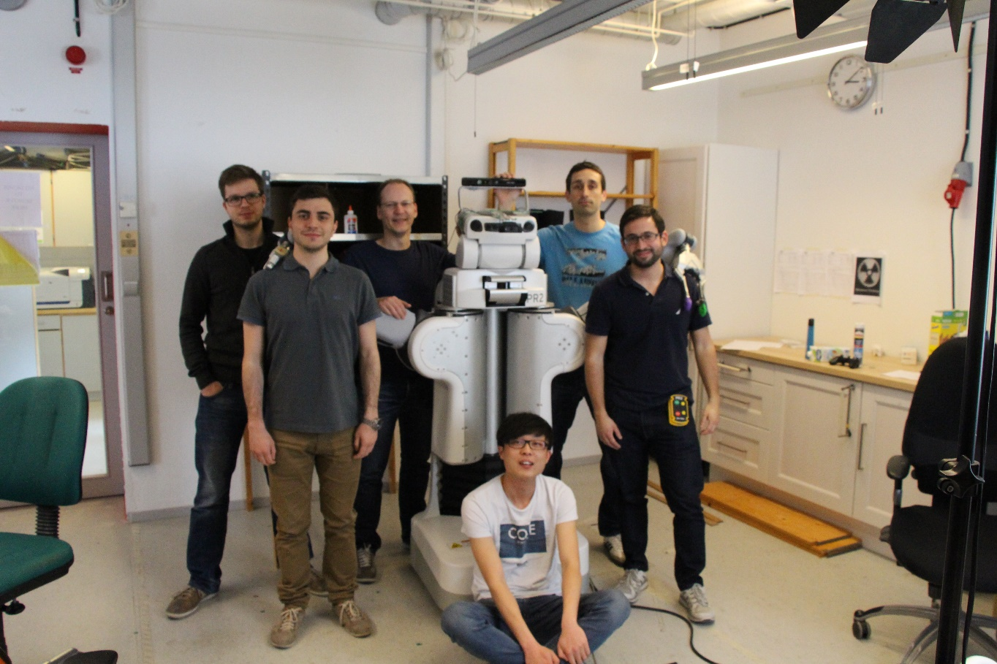
The team
Current and past affiliations here
Hang Kaiyu: Grasping
Francisco Vina, Grasping and PR2 Specialist
Michele Colledanchise, Behavioral Trees
Karl Pauwels, Computer
Alessandro Pieropan, Computer Vision and project leader
Prof. Danica Kragic

Slide 3
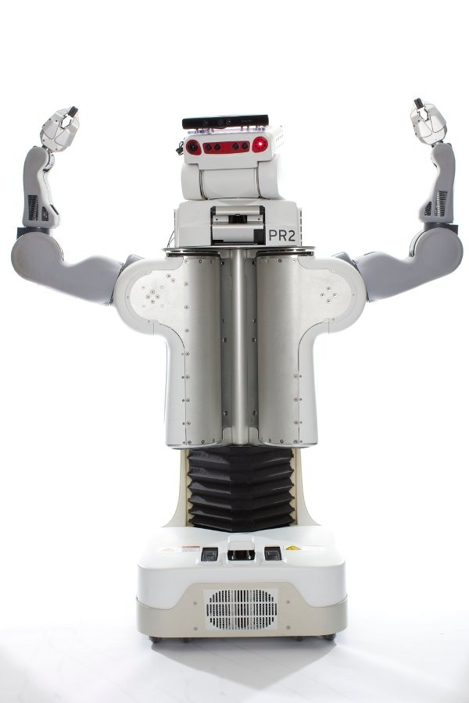
The Robot
Torso is very slow to raise ( 30 seconds)
Hand is very large making grasping very hard in the bins
Cannot reach the top level of the shelf
Cannot grasp wide or flat objects

Slide 4
Strategy
Tasks ordered by number of objects in bins and level of shelf
Non graspable objects are removed from the queue
Bins with 3 or more objects left at the end
Move the robot to the desired bin
Find the object in the bin and grasp it
Pick the object
Drop the object

Slide 5
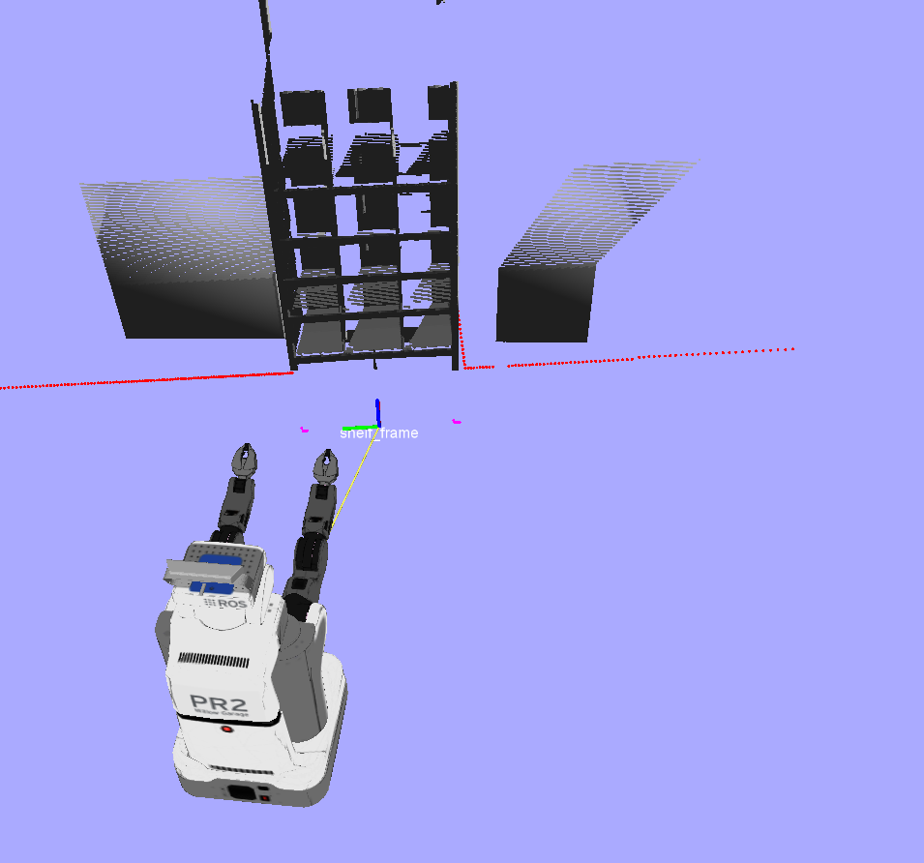
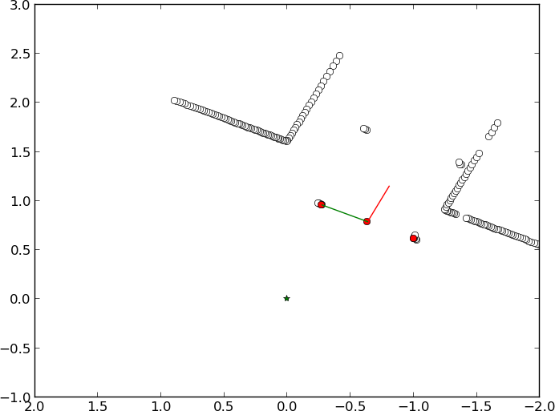
Shelf Localization
Base Laser scanner
Point cloud clustering to find legs
Triangulate legs and the base_laser_link
Position and orientation
Remember and updates the position of the legs
Robust to noise
Recovers from occlusion

Slide 6
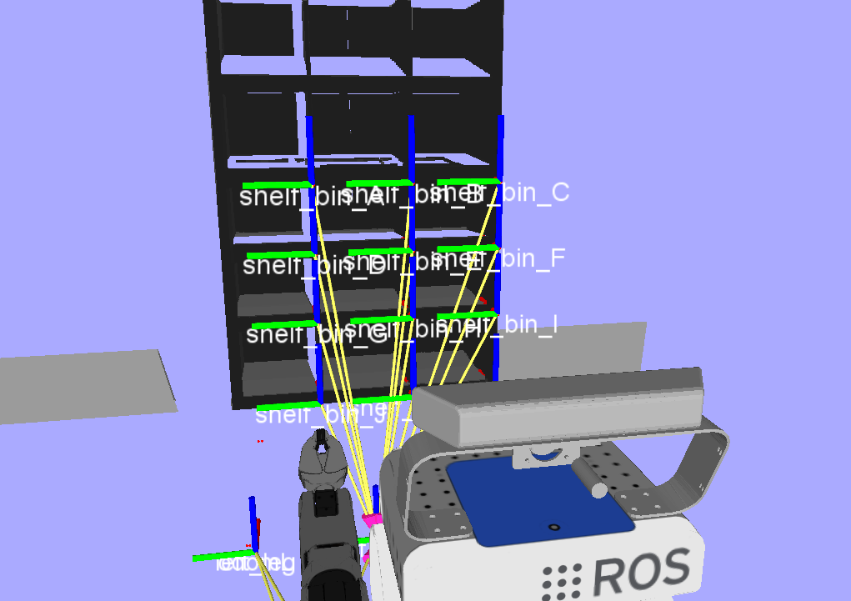
Definition of waypoints
Position of each bin is known
Define navigation waypoints to reach the shelf
Define perception/manupulation waypoints to move the arm in front of each bin
Only the last step of grasping involves some kind of reasoning

Slide 7
Behavior trees
Easy to develop and test
Execute External ROS nodes (C++ or Python)
Each Module should be standalone (i.e. know when to start and report if it has succeeded or not).

Slide 8
Final Design
If the list of objects to pick is not empty: Detect, Grasp, Drop Object
and then go to the next object
?
If some action fails (we cannot deal with that object),
we the put the object at the end of the list of objects to pick
(we will try again later)
List of Object Empty
→
?
Drop
Object
Remove
Object from List
Base, Torso, Head, Init
→
Next
Object from List
Incrementally added more functionalities
(initialization and pre-grasp poses)
Detect Object
Pre-Grasp
Grasp Object

Slide 9
Ideal Design
The ideal design is more reactive
And handles better the action failures
?
List of Object Empty
→
→
→
Object possible to recover
Append Object
to List
Object impossible to recover
Remove
Object
From List
Base, Torso, Head, Init
?
?
?
Remove
Object from List
Object Position Known
Detect Object
Object Grasped
→
Object Dropped
Drop
Object
Pre-Grasp
Grasp Object

Slide 10
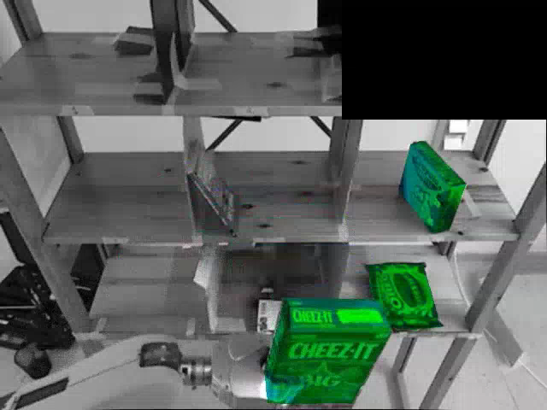
Perception
2 strategies
Object detection and 6DOF estimation using Simtrack
Cloud clustering to find potential unrecognized objects

Slide 11
Building the Point Cloud of the Bin
Shelf localization to find position of the right bin
Cloud built using Kinect and tilt laser scanner on the torso
Crop the cloud to have points inside the bin boundaries
Iterative Euclidean clustering to fit the known number of object in the bin

Slide 12
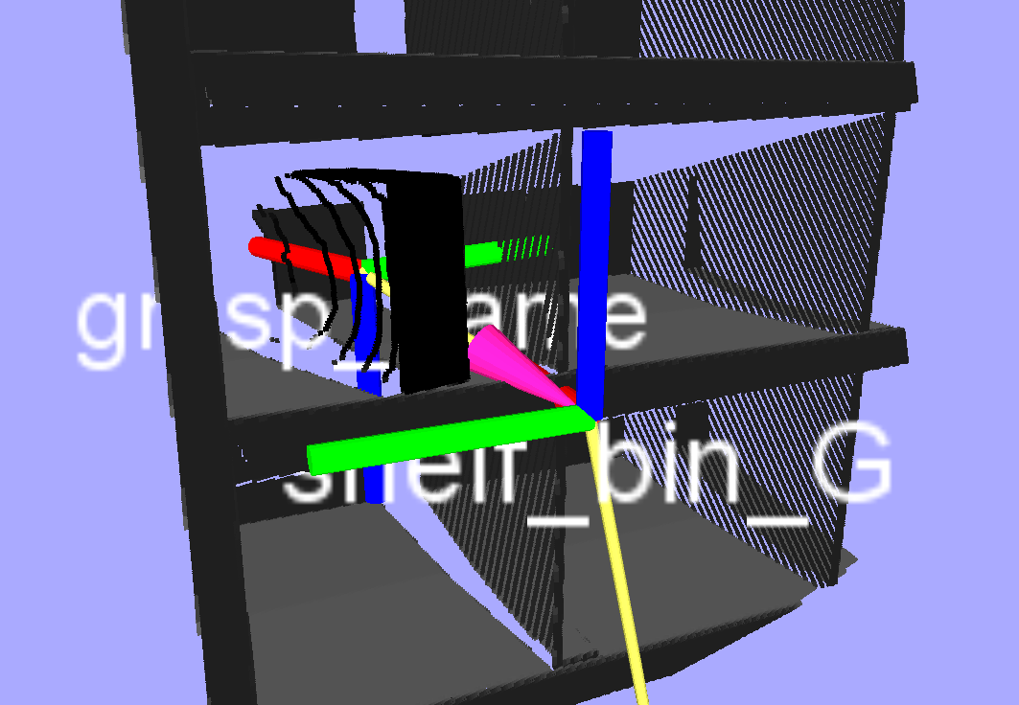
Grasping
7 steps:
Object detection (SimTrack + Segmentation)
Pre-grasping (posing gripper in front of the bin)
Reaching (reach the grasping point, i.e. object center)
Grasping
Prepare for retreat (lifting + centering in bin)
Retreat (drive the robot backwards)
Dropping

Slide 13
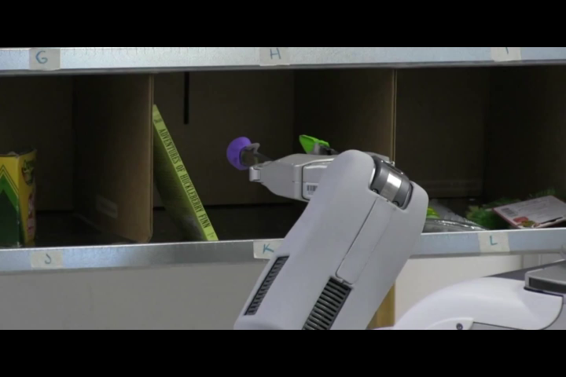
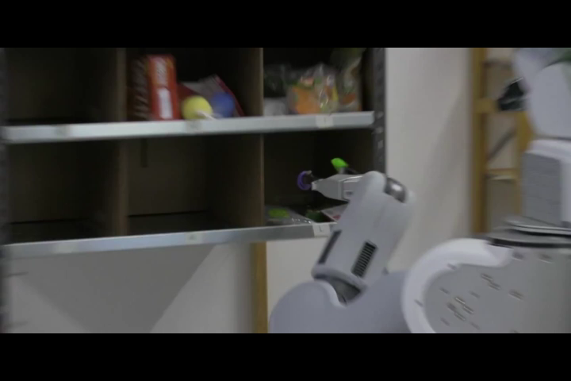
Grasping
Side-grasping:
Yaw: allow +- 15 degrees freedom
Roll: always 0
Pitch: always 0
Reaching distance: grasping dictionary based
Top-grasping:
Yaw: +- 15 degrees freedom
Roll: always 0
Pitch: 15 – 45 degrees
Touching: grasping dictionary based
Grasping dictionary:
Objects dimensions
Graspable faces
Detection methods
Top/Side grasping

Slide 14
What went wrong in Seattle
PR2 provided by Clearpath
Little time to calibrate it
Lighting condition

